Slide 1
Flipping the Classroom
Chris Edmonds, PhD
University of Alabama at Birmingham
cedmonds@gmail.com
Tom Edmonds, PhD
University of Alabama at Birmingham
tedmonds@gmail.com

Slide 2

The Flipped Classroom
Notes:
Idea of flipped class has been around for awhile but haven’t had the technology available to make it effective.
Being done in K-12.

Slide 3
The Flipped Classroom
Notes:
Idea of flipped class has been around for awhile but haven’t had the technology available to make it effective.
Being done in K-12.

Slide 4
The Flipped Classroom
Notes:
Idea of flipped class has been around for awhile but haven’t had the technology available to make it effective.
Being done in K-12.

Slide 5
The Flipped Classroom
Student Benefits
  Lectures available 24/7
  Have access to the instructor when you need it
Notes:
Idea of flipped class has been around for awhile but haven’t had the technology available to make it effective.
Being done in K-12.

Slide 6
The Flipped Classroom
Instructor Benefits
  More engaged students
  Course management
  Don’t have to repeat yourself

Slide 7
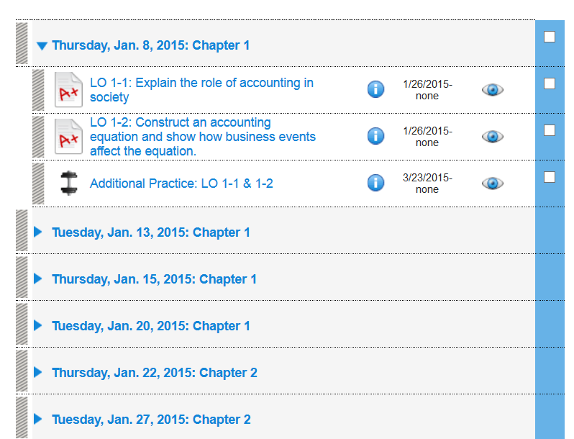
Notes:
Identified 100 LOs
What we do in class 1) Video and Assessment 2) Problems in Class 3) Additional Practice
Introduce Depreciation Video. Follows video on straight-line. Work to tie concepts together.

Slide 8
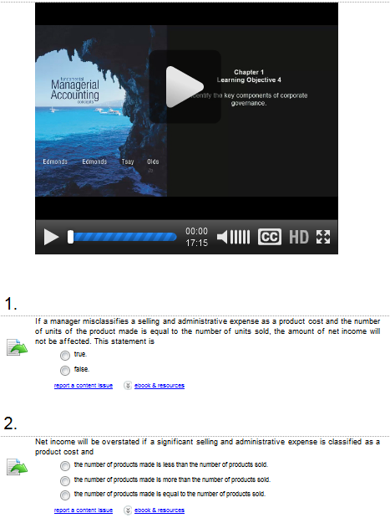

Slide 9
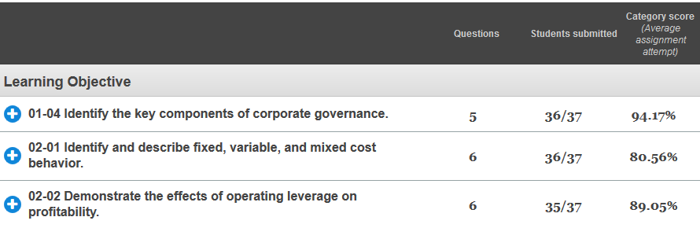

Slide 10
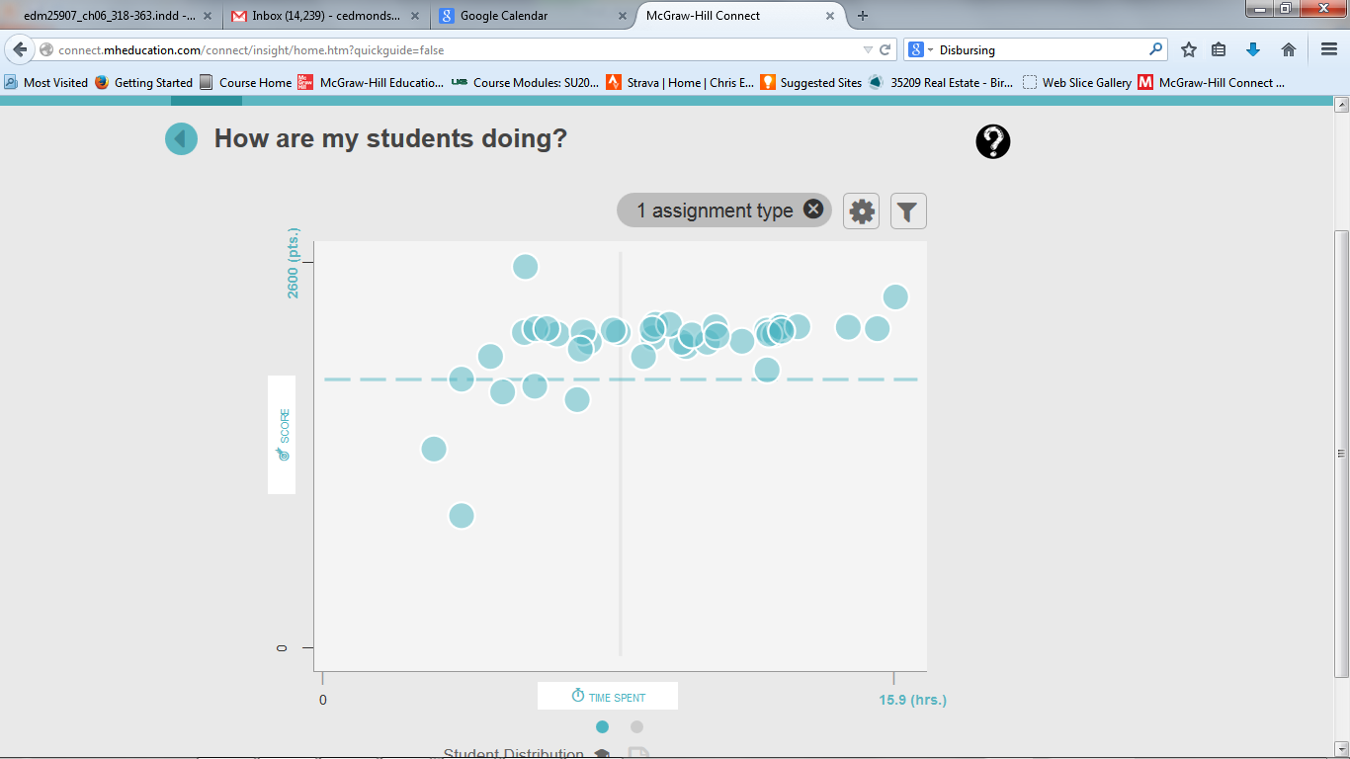
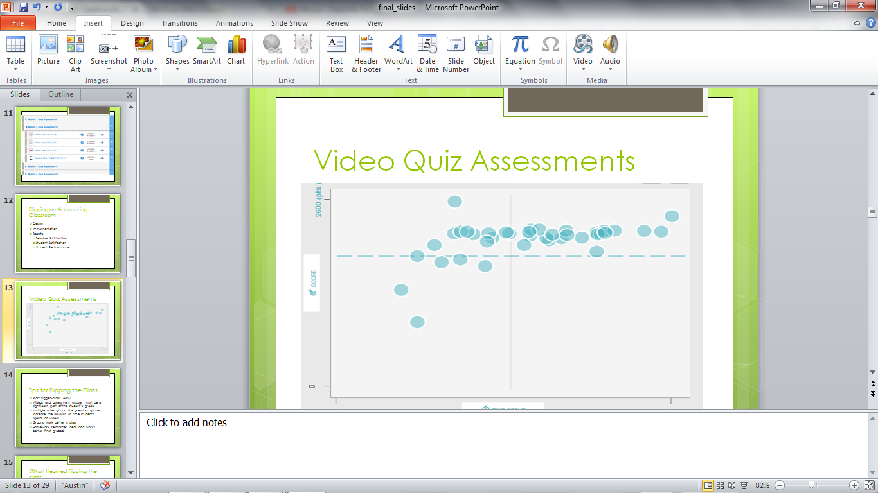
Video Quiz Assessments
80%

Slide 11
What I do in class
Give students a specific task
Mini lecture only if necessary.
Drill until they are confident.
Groups work great but I require them to work individually as well (90 / 10).
Have problems that vary in difficulty. If a student is struggling with a problem assign an easier one.
Use the best students
Notes:
Implement on a gradual basis

Slide 12
Developing Video Content
Notes:
Organizing the content

Slide 13
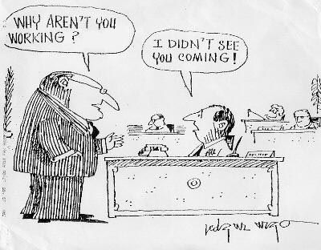
Student Engagement
Notes:
The most important thing is the quality of the content. If you want your students engaged you must provide content that they can understand and that is relevant to their career goals. Content must be understandable and it must be relevant to the accomplishment of their goals.

Slide 14
Importance of Sequential Learning
What is the best starting point?
Entity Concept
Notes:
Sequential learning is just common sense. You cannot understand accounting for uncollectible accounts expense, if you do not understand the concept of accounts receivable. Unfortunately all sequential relationships are not so apparent. I have spent a life time career of identifying the proper sequence for the introduction of content. Started teaching high school bookkeeping. We covered in nine months was is typically covered in the first three chapters of college level accounting. I had time to get to know my students and to identify many issues that confused them. The experience was so interesting, it ultimately defined my career.

Slide 15
Entity Concept
Owners invest $10,000 cash in the business.
Is this a financing, investing , or operating activity.

Slide 16
Entity Concept
Owners invest $10,000 cash in the business.
Is this a financing, investing , or operating activity.
Restructure:
The business acquires $10,000 cash from the issue of common stock.

Slide 17
Entity Concept
Customers incurred $200 of cash expenses from the business.
Cash 200
Revenue 200
Notes:
Another example is bad debt expense. Students struggle with entities especially because they have spent their whole lives being consumers.

Slide 18
What Comes First? Financial Statements or Transactions
Notes:
Sequentially, statements are a summary of events. The events come first so they should be introduce first.

Slide 19
Begin with Accounting Equation
Assets = Liabilities + Common Stock + Retained Earnings
Notes:
What are assets and where do they come from?

Slide 20
Opening Problem
Rustic Camp Sites
Notes:
Start with a specific example such as the one here.

Slide 21
Business Events for Rustic Camp Sites
Transactions for Rustic Camp Sites (RCS).
1. RCS acquired $120,000 cash from the issue of common stock.
2. RCS borrowed $400,000 cash.
3. RCS paid cash to purchase $500,000 of land.
4. RCS earned $85,000 of cash revenue.
5. RCS paid $50,000 for cash expenses.
6. RCS made a $4,000 cash dividend to the owners.

Slide 22
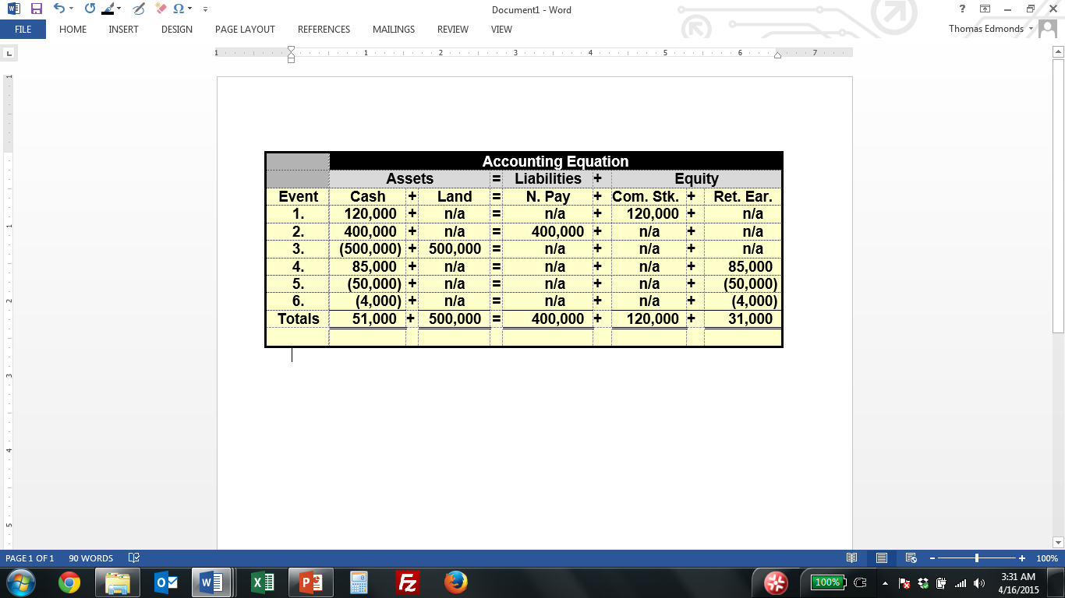
Notes:
Notice that all events are cash events. Students are familiar with cash. Build on what they know. Accruals and deferrals are introduce later. Again sequential learning builds on prior knowledge

Slide 23
Prepare Financial Statements
Income Statement
Revenue (increase in assets)
Minus Expenses (decreases in assets)
Equals Net Income (increase in wealth)

Slide 24
Prepare Financial Statements
Statement of Cash Flows
Operating Activities
Investing Activities
Financing Activities
Change in Cash

Slide 25
Moving forward our primary objective is to teach students to think like a business professional. More specifically the students needs to know how business events affect financial statements.

Slide 26
Financial Statements Model
Assets = Liab + Equity Rev – Exp = N Inc Cash
1. Emphasis is on how events affect statements rather than how they are recorded (i.e., T-accounts and journal entries).
2. Events are analyzed individually instead of cumulatively.

Slide 27
Introduction to Accruals
Allegro Marketing Services provided $78,000 of services to its customers during 2015. Also, during 2015 Allegro collected $64,000 in cash from accounts receivable.
Required: Record these two events in a financial statements model.

Slide 28
Financial Statements Model
(Accrual Accounting)
Cash + A Rec = Liab + C Cap + R Ear Rev - Exp = N Inc Cash
n/a + 78,000 = n/a + n/a + 78,000 78,000 - n/a = 78,000 n/a
64,000 + (64,000) = n/a + n/a + n/a n/a - n/a = n/a 64,000 OA

Slide 29
Multi-Cycle Illustrations
Notes:
The instructor can now add value. Only delivery of content is changing. Before just regurgitate textbook

Slide 30
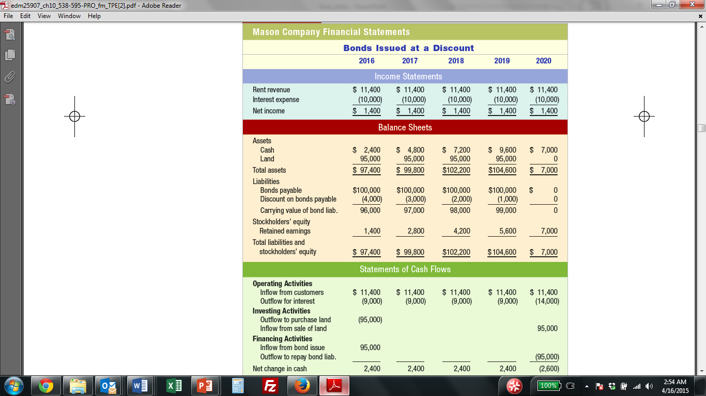
Notes:
Comprehensive rather than piecemeal coverage. Event to financial statements over multiple cycles

Slide 31
Financial Statement Analysis
Coupled with related topics
As a stand alone topic
Demonstrated with real world statements

Slide 32
Creating Videos
    Recording
      Camtasia Studio
      Lenovo Tablet
      Blue USB Yeti Microphone
      Microsoft Word
    Editing
      Average recording file is 3 times longer than edited file
      100 videos in16 hours
      35 hours of lecture time in 14 week class
    Production

Slide 33
Conclusion
Questions?
Contact Information:
  Chris Edmonds: cedmonds@gmail.com
  Tom Edmonds: tedmonds@gmail.com

